Slide 1
Hft accelerator
Pranav sharma

Slide 2
Where are we within the project?
Go around and share what you’ve completed so far
(its fine if you haven’t done much)
Trying to wrap project up in 3 weeks

Slide 3
Project clarifications
You are writing SystemVerilog code that receives 18-byte packets of raw binary containing stock information. Your code will:
  Receive and understand the binary packets in real time
  Contain an algorithm that will decide when to buy/sell
  Send 16-byte formatted packets back to the computer to actually execute the trade
If you have questions at any time, please ask

Slide 4
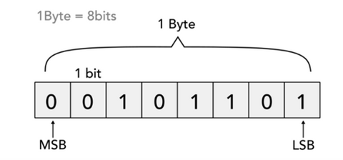
Bits, bytes, and hex
A bit is just an integer ( 1 or 0 )
A byte is 8 bits
Looking at lots of ones and zeroes is unreadable, so hex exists
1010 1010 converts to hex “aa”
0010 1110 converts to hex “2e”
Hex makes binary more readable and compact.

Slide 5
Incoming packets (FPGA receives)
- Byte 0: Start marker (0xAA)
- Bytes 1-4: Stock ticker (4 ASCII chars)
- Bytes 5-8: Unix timestamp : seconds since jan 1, 1970
- Bytes 9-11: Ask price in cents : lowest price a seller will accept
- Bytes 12-14: Bid price in cents : highest price a buyer will pay
- Bytes 15-16: Current position : amount of stock we are holding
- Byte 17: Checksum (XOR of bytes 1-16) : verification

Slide 6
Outgoing packets (FPGA sends)
- Byte 0: Start marker (0xBB)
- Bytes 1-4: Ticker (4 ASCII chars)
- Byte 5: Action (0=HOLD, 1=BUY, 2=SELL)
- Bytes 6-7: Quantity (16-bit shares)
- Byte 8: Order type (0=MARKET, 1=LIMIT)
- Bytes 9-11: Limit price in cents (24-bit)
- Bytes 12-15: Timestamp (32-bit Unix time)

Slide 7
SystemVerilog
A programming language that describes circuits
Runs on FPGAs. Like Arduino, you push the code once and it sits there, running in a loop (while on power)
You can upload code to our FPGA using Xilinx Vivado Design Suite. This program is only available on windows and linux
We can simulate running SystemVerilog code using online intepreters like EDAplayground
Uses testbenches (like tests in any other coding language)\
* show example*

Slide 8
My recommendations
SystemVerilog is a very involved programming language
Later today, I will be uploading a SystemVerilog testbench to discord. You can use it to simulate the full loop. It will feed formatted packets to you every 0.5 seconds.
  Due to time crunch, use whatever resources you can (AI)
  Just run on EDAPlayground
Next week, I will have an example module prepared and you can see the full loop of incoming packets -> FPGA -> trades

Slide 9
Project wrap up
In two weeks, I hope to have some completed modules. In the week following that, I will run each of the modules for some time each.
The one that makes the most money (if any) – I’ll give you like 30 bucks or something

Slide 10
Project proposals
Tuesday, Jan 20th @ 7PM
ECE 269 (TBD)

